Slide 1


REACT JS1695378082452.PPT
Development

Slide 2
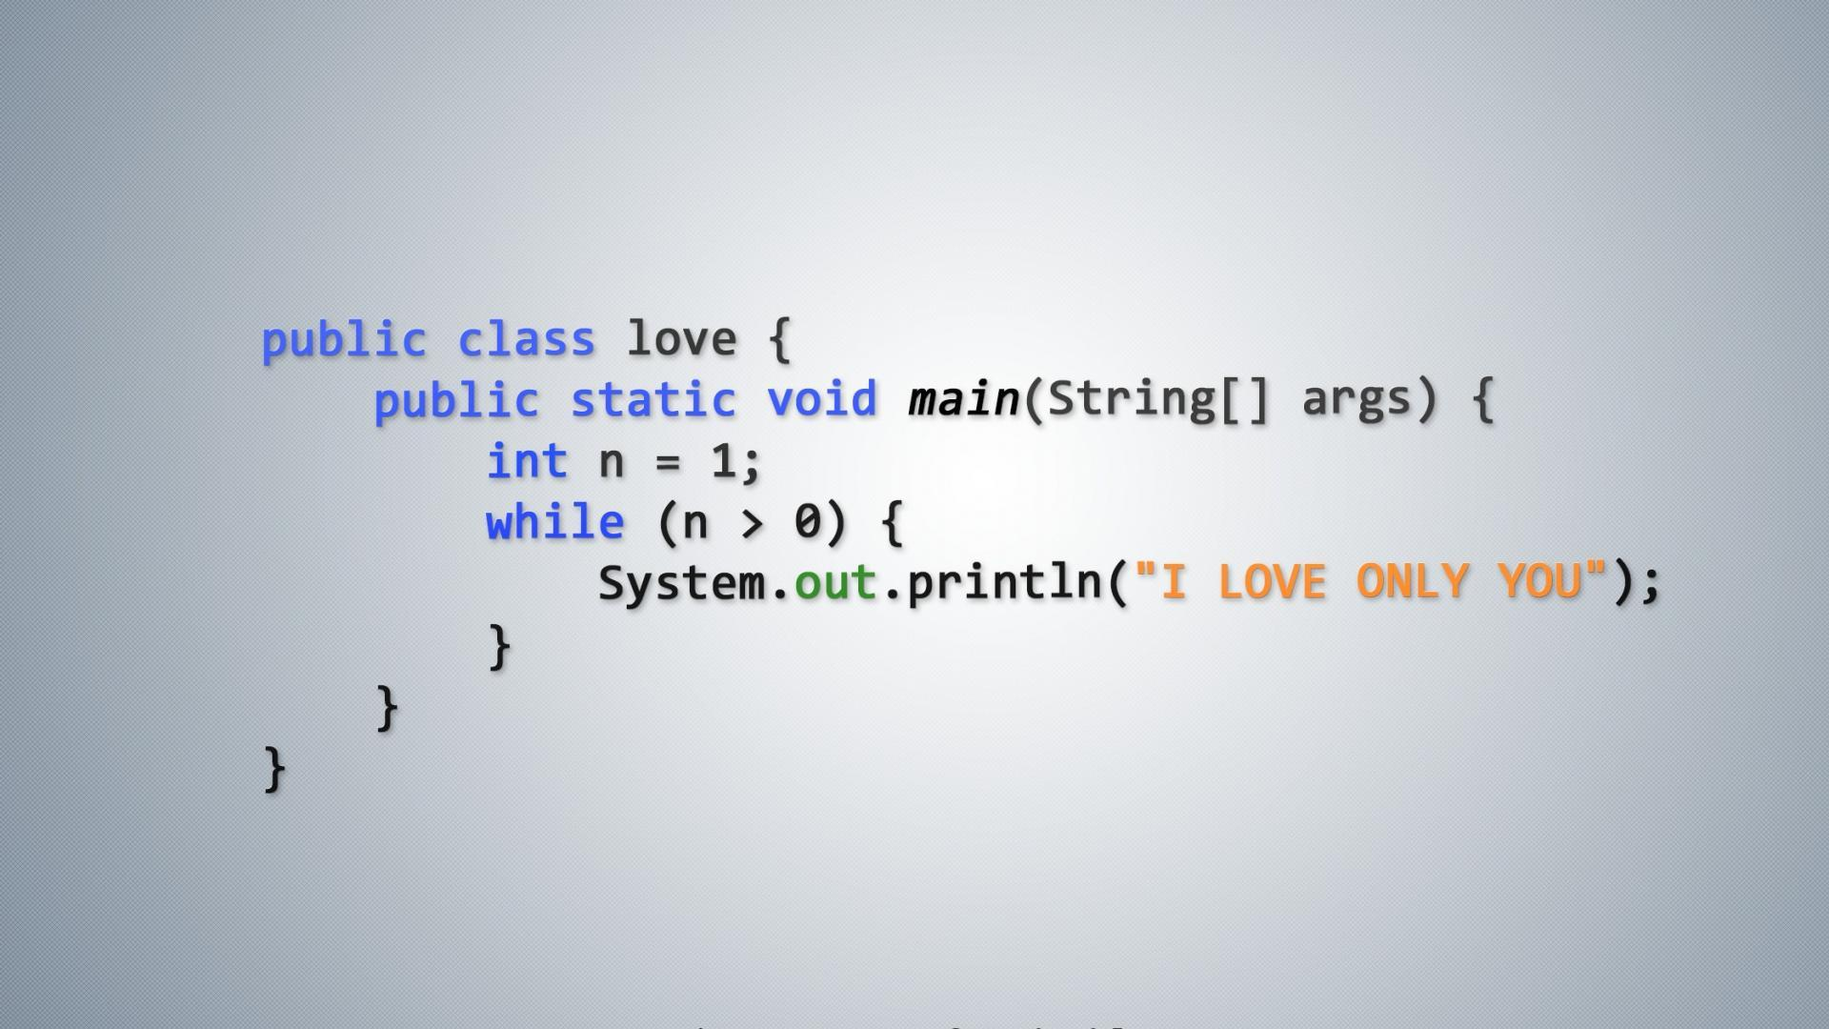

Slide 3
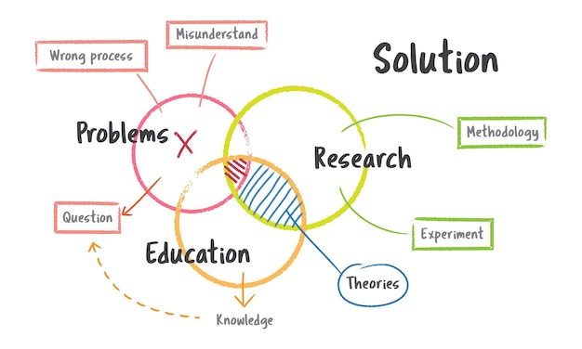

Mobile Application DevelepMent

Slide 4

New World

